Slide 1
Introduction to Coding in Python
Files needed today:
python_practice.py [canvas]
Dr. Groves
Dr. Peirce-Cottler
Module 0 Lecture 1
Learning objective: I can do basic tasks in Python (loading a file, writing a for loop, calling a function) using VS code or another IDE.

Slide 2
You should have:
Anaconda installed
VS Code installed (or an IDE you like)
A GitHub account
In module 0, we will add:
A folder location to organize your files (code files and data files for this class)
VS Code extensions:
Jupyter notebook extensions
Optional extensions: CSV viewer
Python packages needed for this class
Github repositories for each project
Setting up your computer for this class
Notes:
I have tested the install process I’ll walk through today, but there will always be errors because everyone’s computer set up is different. Make sure you’re able to complete all of these steps and if not, come to office hours tomorrow or reach out to us on piazza
You should have learned coding basics (prompt students?)
What we found last semester was that a lot of students needed help with getting their computer set up in a way that made coding seamless, so they could focus on writing good code that worked well and tied all of the pieces together
We found that even if they could write a for loop or if statement, it was often hard to understand why sometimes code ran in different places, or why they needed anaconda in the first place
A lot of students also needed some coding principles or guiding practices, more than a regurgitation of syntax or basic coding structures that they could google. Where students were struggling was often, I don’t know how to interpret coding errors, writing repetitive code that then made mistakes because things were copied and pasted multiple times, just figuring out how to even structure an approach to the problem they were solving (in plain English)

Slide 3

How do coding tools fit together?
Writing code ≠ running code
Think of coding like running a restaurant
.py files
Jupyter notebooks
VS Code (IDE)
Python interpreter
Terminal/Command Prompt
Anaconda & environments
GitHub and git
Your code = the recipe
It describes ingredients and steps, but a recipe does not cook itself!
.py file
Notes:
Start by talking about my rationale for this intro based on the last two semesters of feedback and problems that arose

Slide 4

Folder Organization: The recipe book
Pick one location to make a folder for this class (Documents? UVA Box? Home?)
Each Module will have its own subfolder that we will put in this folder
Any extra data/files from Canvas should go here
Think about what you want to name your files!
Notes:
Naming conventions for files and folders
Enumerate code in a pipeline when step-by-step (1_xxx.py, 2_xxx.py, etc)
Python files should have a clear, descriptive name for importing (numerical_solvers.py, statistical_tests.py, classification.py, etc)
No files should have “template” in the title (i.e. rename any files you get from Canvas!)

Slide 5

Python interpreter: The Chef
The chef reads the recipe line by line and executes each instruction
Different chefs exist:
Python 3.7
Python 3.9
Python 3.11 …
Same recipe with different chef → slightly different outcomes!

Slide 6

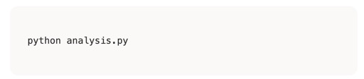
Terminal & Command Prompt: The Order Counter
The terminal is where orders are placed
Means “Chef Python, make the analysis.py recipe”
We can access the terminal through stand-alone apps (terminal, command prompt) or within VS code
Like different windows at the same order counter

Slide 7
The Restaurant: The Big Picture
… and put them in a recipe book (folder)…
… which you can send to the order counter (terminal)…
…which tells the chef (Python) what to cook
You write recipes (code)…
I need an analysis.py, stat!
The Restaurant (VS Code)
All of this happens inside the restaurant, VS Code!

Slide 8
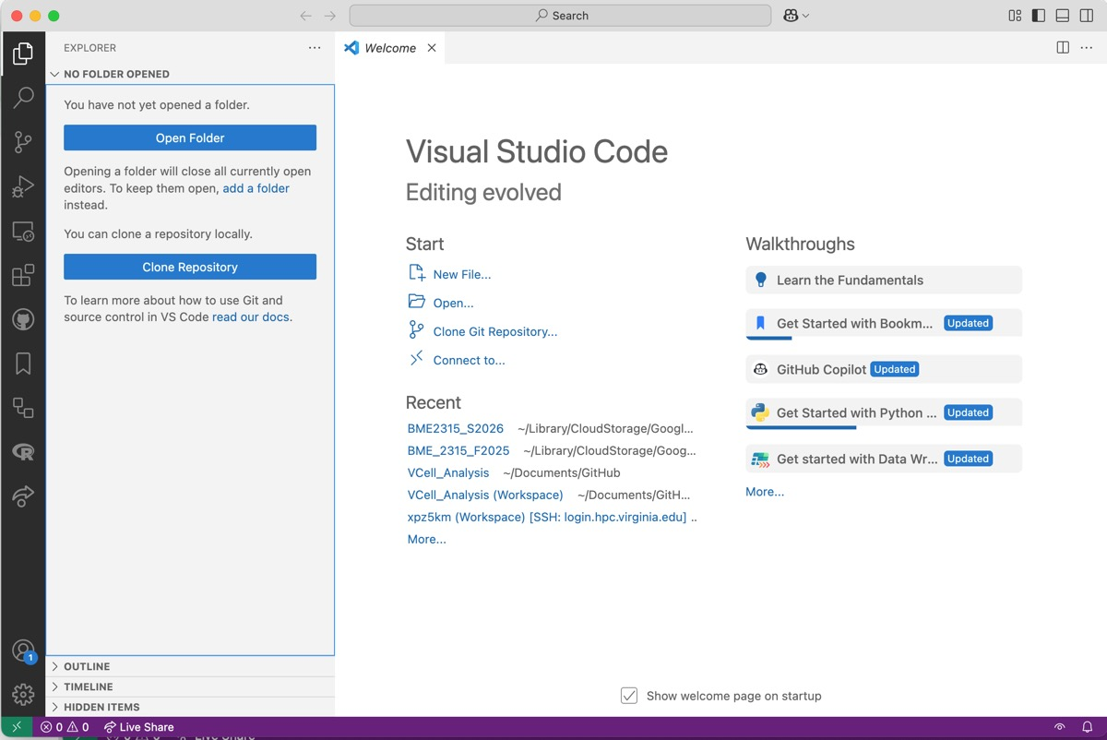
VS Code & Integrated Development Environments: The Restaurant
VS code is a place to work on code (write recipes), view data files (peek in the kitchen), and run your code through a terminal (tell the chef what to cook)
Integrated: many tools in one place
Development: place to build code
Environment: workspace

Slide 9
Let’s practice!
Make a folder for this class on your computer.
Open VS Code (or another editor).
Stand your name card up on its edge when you are done. Raise your hand for help!

Slide 10
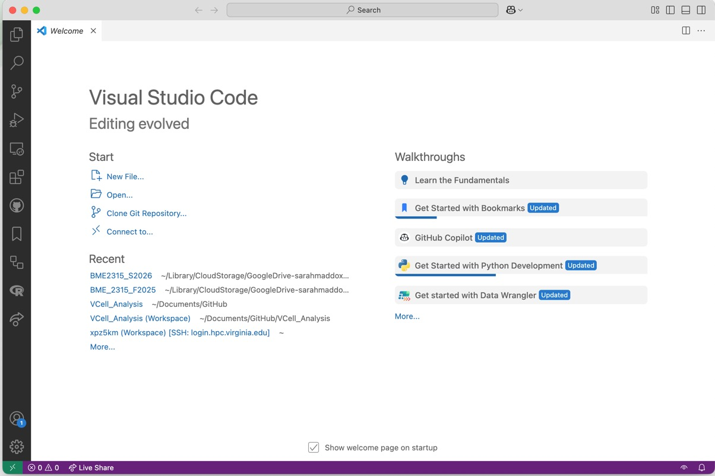
VS Code IDE
Welcome screen
Open a folder
Recently opened folders
Always start by opening your class folder from VS code!

Slide 11
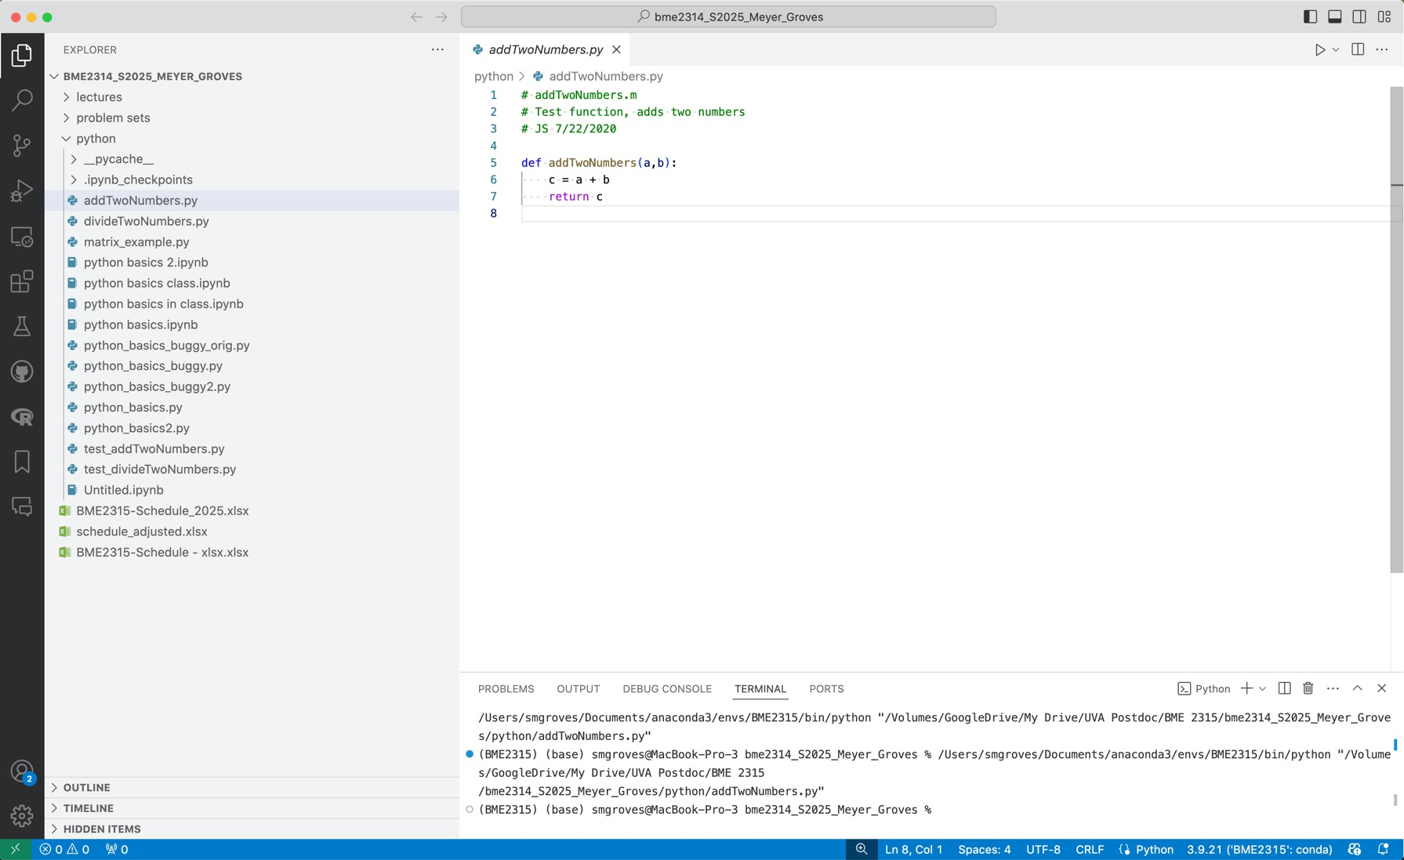

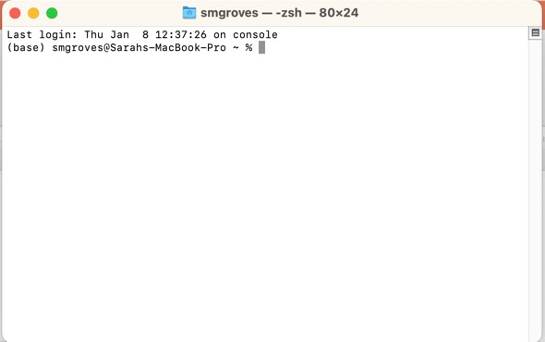
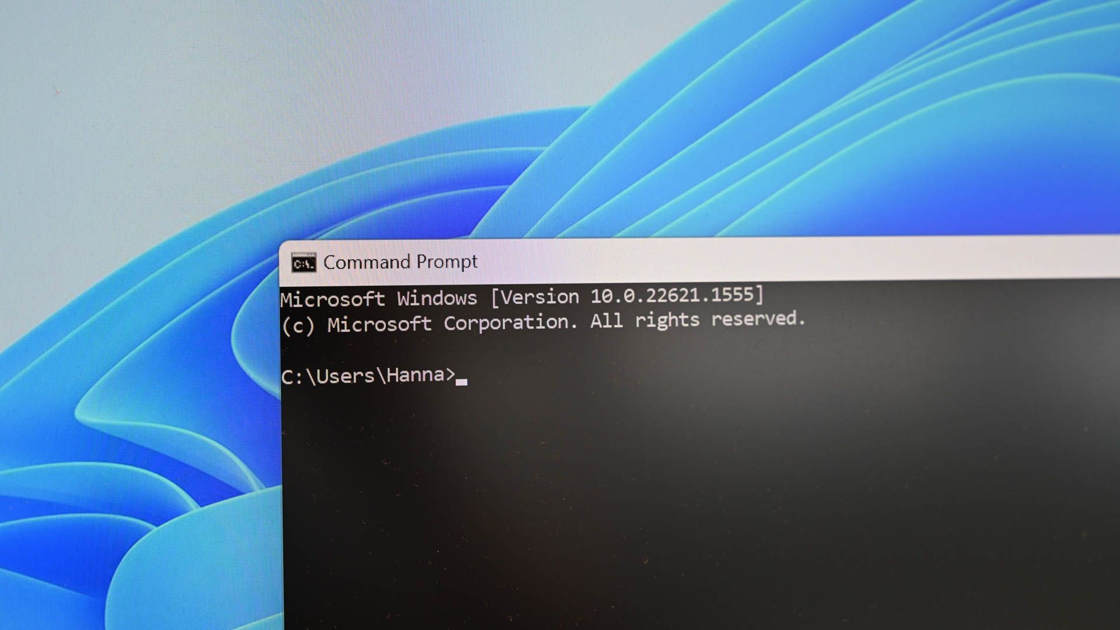
VS Code IDE
Add a file Add a folder Refresh Collapse all folders
Search or run a command
Your chosen folder!
File Explorer
Name of file
Search
Run File
Script Editor
Extensions
Terminal (Mac)
Command Prompt (Windows)
Console/Terminal/Output
Python version

Slide 12
Let’s practice!
Open the folder for this class in VS code.
Add python_practice.py from canvas into this folder and open it in VS code.
Go to the extensions marketplace and download Python & Jupyter.
Stand your name card up on its edge when you are done. Raise your hand for help!
Tip: File > New Window will open a new window with the welcome page again

Slide 13


Anaconda: The supplier & pantry Conda environments: The kitchens
Anaconda is the supplier that includes Python and scientific libraries
The package manager gives you a stocked pantry
Conda environments = separate kitchens
The base environment is the default
You can make as many environments as you want. This is useful for organizing projects.
Each kitchen can have different chefs (Python versions) and different pantries
Ensures there are no “ingredient conflicts”
VS code works in one kitchen at a time
“This special package requires python 3.7”
conda create …
base (default)
special_env_1
special_env_2
Python 3.11
Numpy 2.4.0
Pandas 2.3.3
…
Python 3.7
Numpy 1.9.1
Special 1.0.0
…
Python 3.11
Matplotlib 3.10.8
Seaborn 0.13.2
…
conda activate …

Slide 14
The Restaurant: The Big Picture
…to different kitchens (environments)…
Anaconda supplies the ingredients…
I need an analysis.py from the blue kitchen!
Orange kitchen, get me a statistics.py!
You write recipes (code)…
… and put them in a recipe book (folder)…
… which you can send to the order counter (terminal)…
…with different chefs (Python versions)…
…which tells the chef (Python) what to cook
The Restaurant (VS Code/IDE)

Slide 15
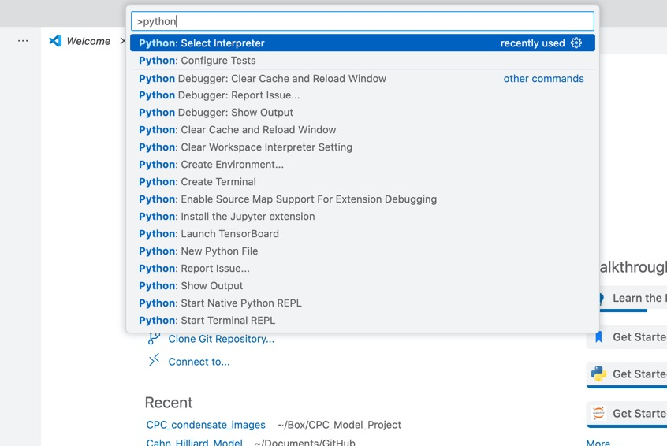
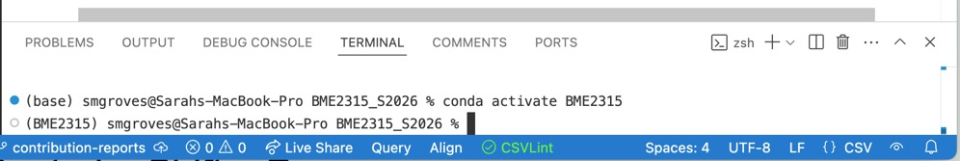
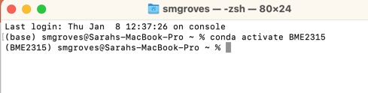
VS Code IDE
Terminal
Which kitchen, chef & pantry do we want?
The base env is already activated
I am activating a special env (BME2315)
“conda activate BME2315”
“source activate BME2315”
Command palette: Command/Control + Shift + P
Configures the right version of Python for this specific terminal session
Do this when installing packages
Configures the right version of Python for the entire IDE
Do this once!
Notes:
Selecting the interpreter via the VS Code Command Palette configures the entire IDE experience (linting, debugging, run button, etc.) for that environment, and will automatically activate that environment in any new terminal windows you create. Activating an environment directly in the terminal using commands like source activate only affects that specific, single terminal session.

Slide 16
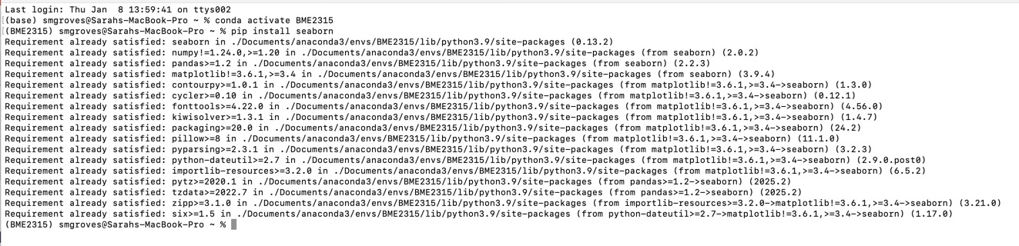
Importing packages (adding food to the pantry)
conda and pip are two major “warehouses”
Most python packages are hosted on Python Package Index (pypi) and can be installed with pip
Ensure the right conda environment is activated to add the package in the right location
If a package is not available through pip, try conda (or look at the install guide)

Slide 17
Let’s practice!
(1) Using the command palette, select the base environment in VS code
OR
(advanced, in terminal*) make a new environment for this class and select it in VS code.
(2) Using the terminal (in VS code or separate app), activate the conda environment and
pip install pandas numpy scipy ipykernel matplotlib
Stand your name card up on its edge when you are done. Raise your hand for help!
*conda create --name BME2315_S26 python=3.12 numpy pandas scipy ipykernel matplotlib

Slide 18
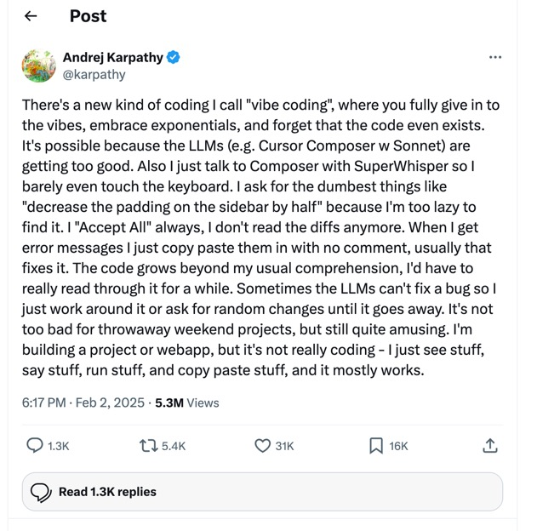
Using genAI for coding
Co-founder of OpenAI (ChatGPT)
Director of AI at Tesla
Notes:
Messy code – AI might generate inefficient or hard-to-maintain code. → Clean up as you go and keep things modular.
No long-term structure – Projects can become chaotic. → Add structure once your prototype works.
Debugging can be hard – Fixing errors might require deeper knowledge. → Ask the AI to explain the bug before fixing it.
Security gaps – AI might skip validation or safety checks. → Always test thoroughly and use sandboxed environments.
AI researcher^{[4]} who served as the director of artificial intelligence and Autopilot Vision at Tesla. He co-founded and formerly worked at OpenAI,^{[5][6][7]} where he specialized in deep learning and computer vision.^{[8][9][2][10]}

Slide 19

The Restaurant: The Big Picture
This dish tastes disgusting! Who made it?
I just followed the recipe that ChatGPT made me… I don’t know where I went wrong.
The Restaurant (VS Code/IDE)

Slide 20
What should we do instead?
Open in VS Code the python_practice.py* file you just added to your folder
*The completed practice is due next Thursday 1/23
Notes:
We had a survey last semester asking if people felt like they were relying on Chatgpt too much for coding, where they felt like they needed more skills
These ideas and tips are things I put together to address a lot of those places where students felt they were lacking
If you work on these skills in this class, you WILL become a better coder guaranteed

Slide 21
Announcements
Open: python_practice.py in VS Code in your folder!
Python practice (submitted through GitHub) will be due TUESDAY January 27 by 12:30pm
Rubric for Module 0 individual assignment:
GitHub Repo for Module 0
ReadMe updated
Python practice file on your own branch with all problems completed
Jupyter Notebook

Slide 22
Tip # 1: Run code in “chunks” when developing
Or, how to break code into smaller pieces that are easier to run and interpret with interactive mode or Jupyter notebooks

Slide 23
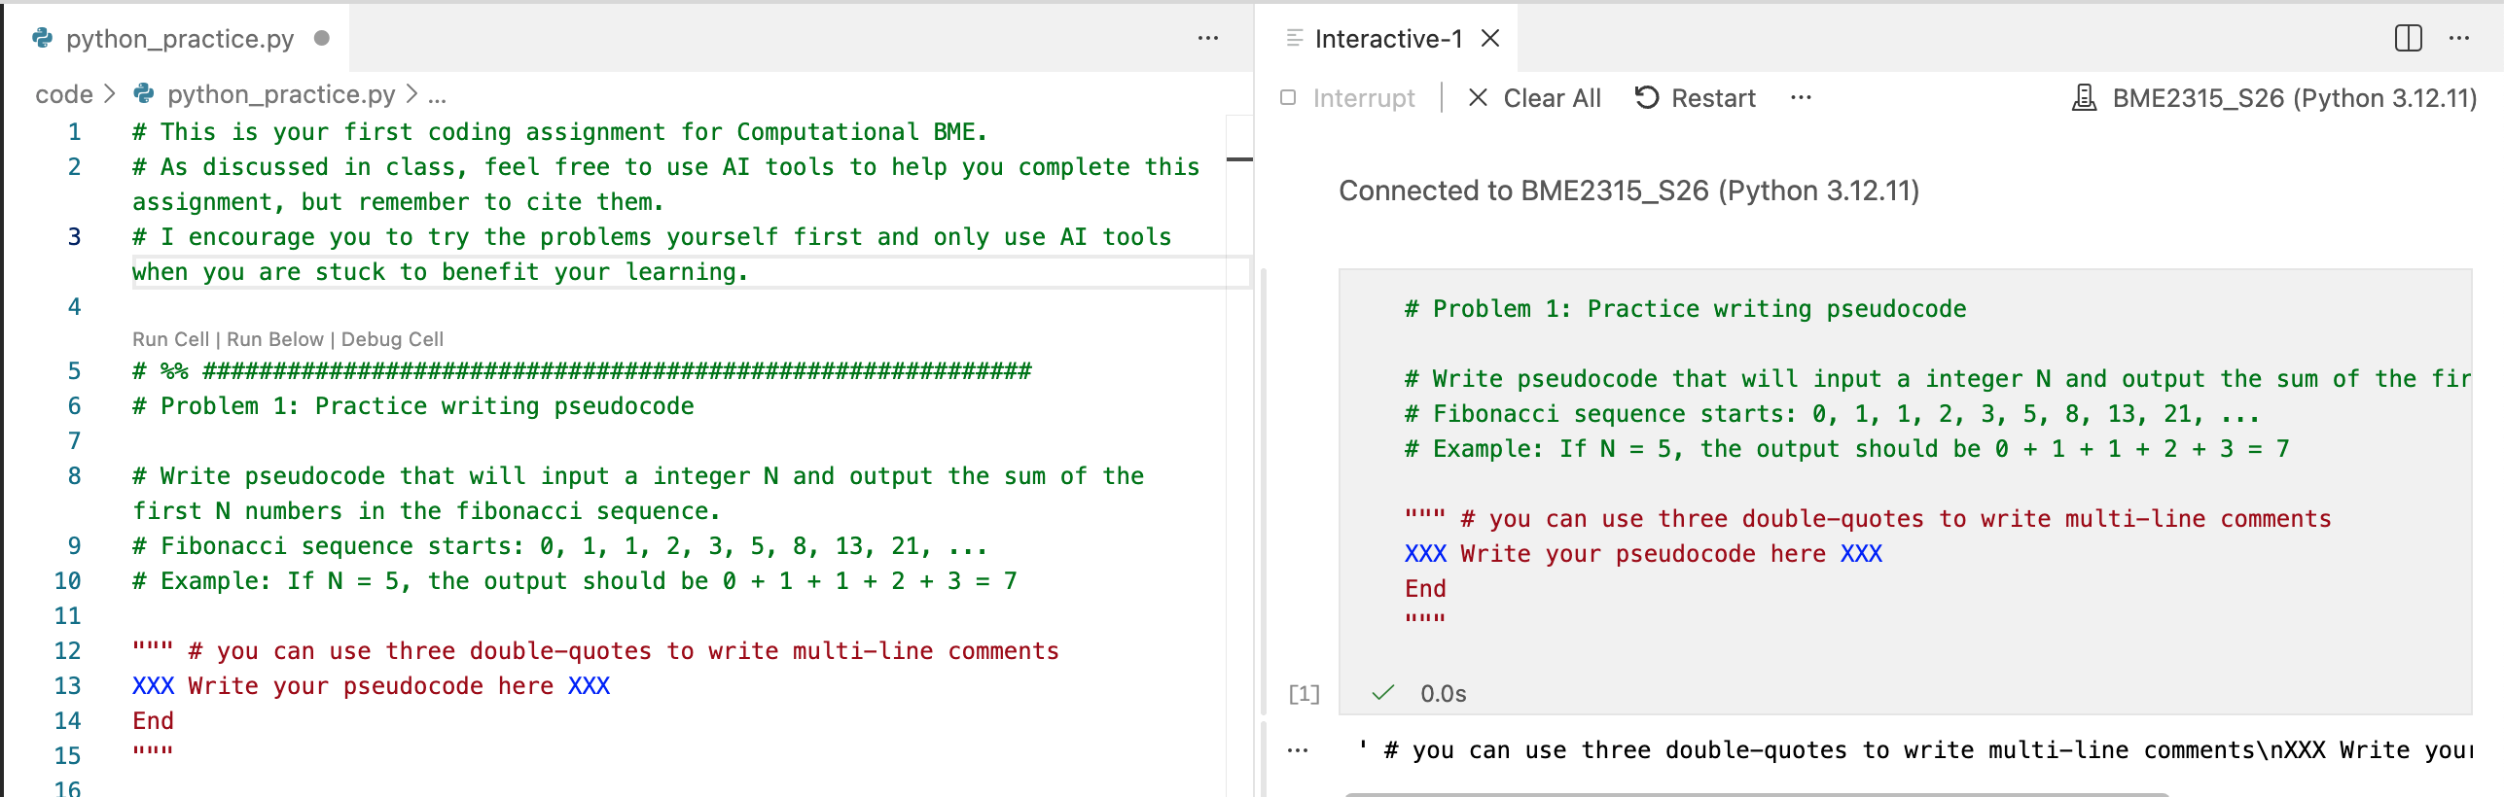
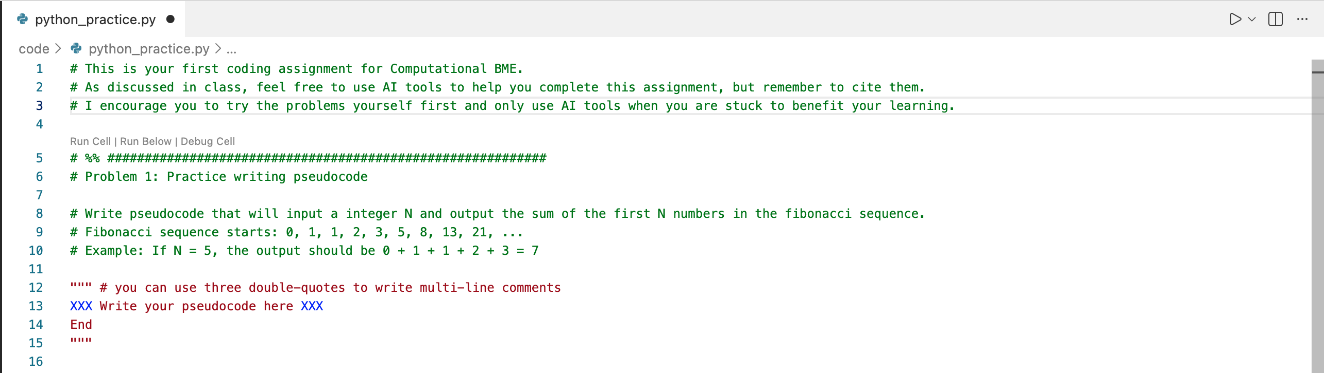
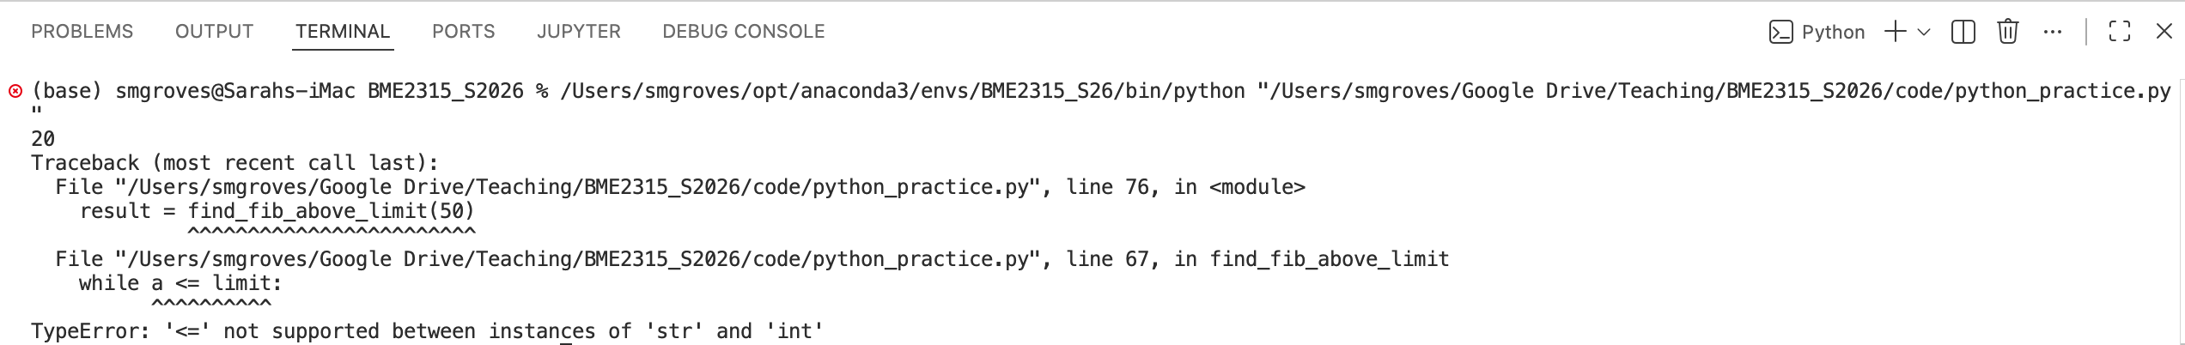
Interactive mode in Python
Try following along on your own computer!
#%% will make code cells that can run in interactive mode within a normal .py file
Requires Jupyter extension (running Jupyter in the background)
Run file in terminal
File is not saved!
Script (“Recipe”)
Interactive “notebook”
Python interpreter in current conda env
Code cell
Code results & plots show up here
https://code.visualstudio.com/docs/python/jupyter-support-py

Slide 24
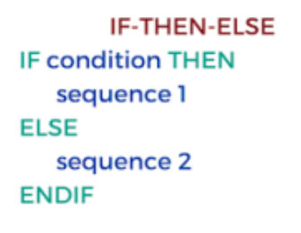
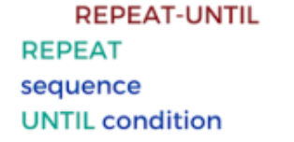
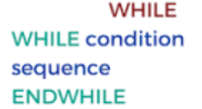
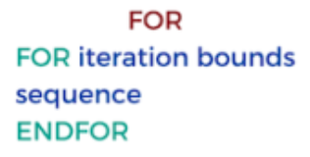
Tip # 2: Write pseudocode first
In plain English, write out (line by line, as the computer should see them):
What are the inputs?
What are the outputs?
What is computed or calculated?
What variables are set or initialized?
Any logic statements like
Any loop structures like
Or, how to design a project and decide what even needs to be coded before starting
Problem 1

Slide 25


Tip #3: Comment your code
You should try to be as descriptive as possible, based on the context of the problem you are solving
In the practice problem, it will not be helpful to say:
Instead, say:
Or, how to remind a future you what you did and why
Problem 2

Slide 26
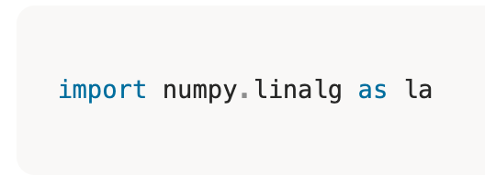
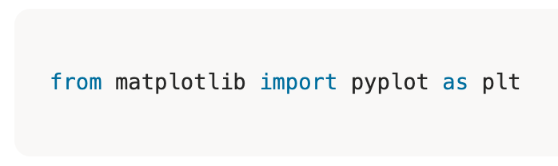
Tip #4: Don’t reinvent the wheel
Modules (ingredients) come from warehouses (Python libraries)
Anaconda, the supplier, pulls from these warehouses and the ingredients end up in your pantry (conda environment)
Any package you have installed in your environment can be used in your code with import statements
Means “Go to the NumPy warehouse, bring the linalg ingredients into my pantry, and label them la.”
Means “From the matplotlib warehouse, grab pyplot and label it plt”
Or, how to use common Python libraries to make things easier and more efficient
La.norm()
From numpy.linalg import *
Norm()
Problem 3

Slide 27
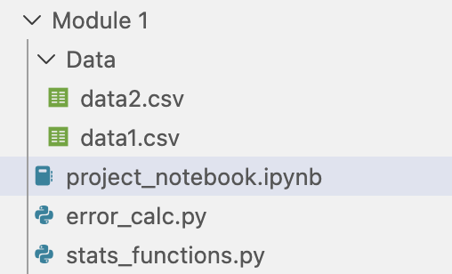
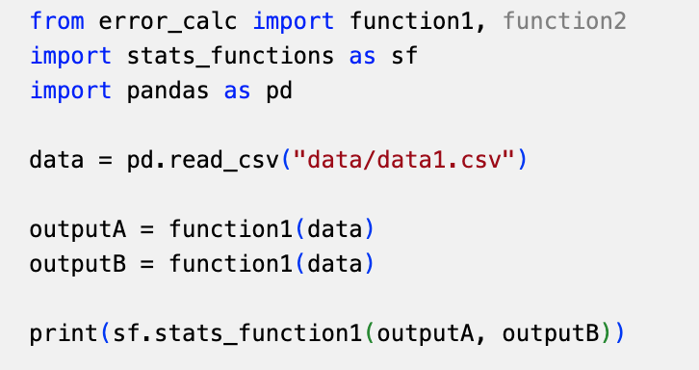
Tip #5: Don’t repeat yourself
Whenever you can think of a chunk of code as a step in a process, it is useful to write it as function
Apply the same code to different inputs
Import your own functions from modules (.py files) into your final Jupyter Notebook report
Example folder structure:
Example implementation in project_notebook.ipynb:
Or, how to recognize when you should write functions and loops
Problem 4

Slide 28
Tip #6: Read your error messages
Somewhere in the code, you asked me to print 20…
Or, how to decode what is going wrong and figure out a fix
“Python, run python_practice.py”
On line 76, I tried to run the “find_fib_above_limit” function…
…which is defined around line 67, and this function has an error…
…because you asked me to compare a “string” to an integer
Problem 5

Slide 29
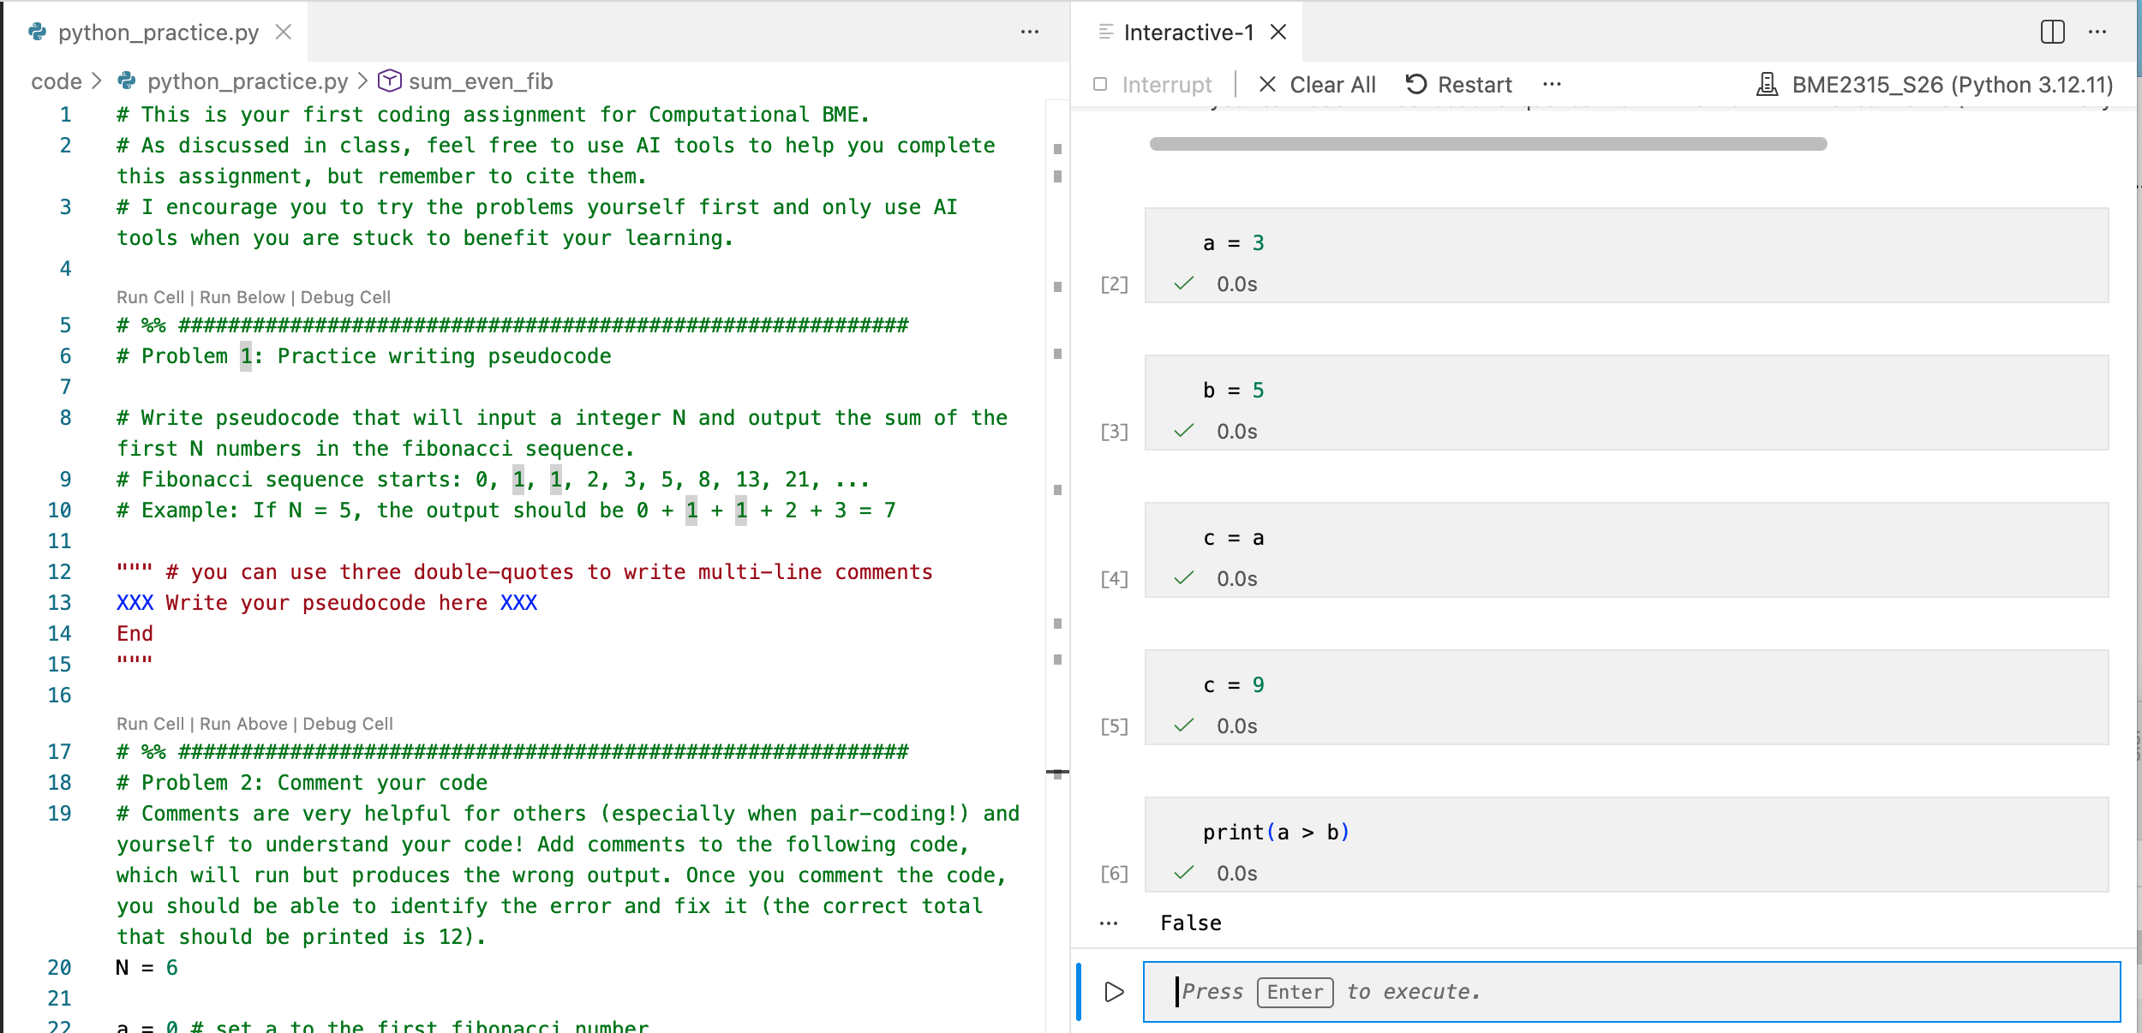
Tip #7: Test your code
Think of different use cases for a function you write
Consider the extremes of the use cases
Write tests that run the function for those extremes, and then check if the answer is correct
If things are hard to decipher, add lots of print statements!
In interactive mode, you can type directly into the notebook
The notebook will remember any variable in this session, but they are cleared once you close out of the notebook
Or, how to make sure yourself that your code doesn’t fail before someone else finds out first
Print(“1st problem”, variable_A)
Problem 6

Slide 30
Homework
By next class: download GitHub Desktop app if you aren’t familiar with using GitHub (otherwise command line is fine!)
Complete video assignment and comprehension quiz (remember you can retake it as many times as you’d like!)

